Slide 1



Advanced Operational Global Tropical Cyclone Forecasts from NOAA's High-Resolution HWRF Modeling System
Performance of the 2014 HWRF and Plans for 2015
Vijay Tallapragada & HWRF Team
Environmental Modeling Center,
NCEP/NOAA/NWS, NCWCP, College Park, MD 20740.
69th IHC/TCRF, March 4, 2015
Notes:
1
1

Slide 2
Outline
Performance of current operational HWRF for 2014 season
HFIP supported Special Projects and Real-Time Parallel HWRF Experiments
Performance of HWRF in the all global tropical ocean basins
Further enhancements to the HWRF modeling system for 2015 hurricane season

Slide 3
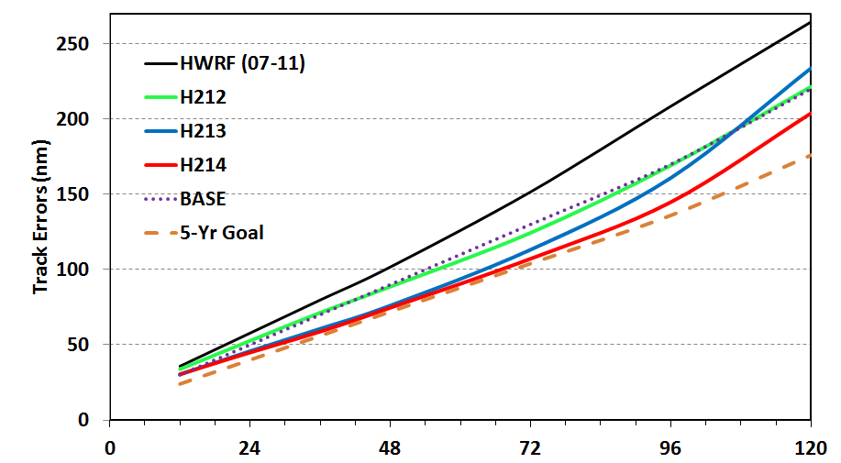
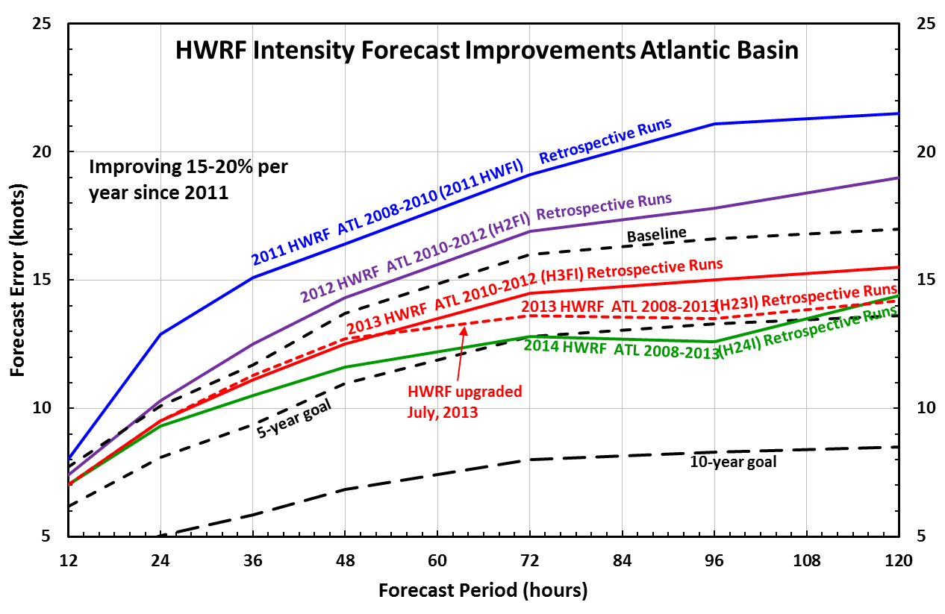
Highlights of 2014 HWRF
2014 operational HWRF upgrades included:
  Increased vertical resolution (from 43 to 61 levels); Increased model top (from 50 hPa to 2 hPa); Increased nest domain size (20% for 9km; 10% for 3km), coupled to higher resolution (1/12 deg.) MPIPOM-TC with uniform trans-Atlantic basin and 3D ocean for Eastern Pacific basin
  Revised and more advanced vortex initialization including cycling of Invests; Further advancements to one-way hybrid GSI including assimilation of TDR/Dropsonde/Satellite data in the hurricane core and environment
  Improved nest tracking, advanced diagnostic products and several product enhancements
  No major physics upgrades compared to 2013 version due to negative impact on intensity forecasts
Significant Improvements in Track and Intensity Forecasts
Demonstrated Through Systematic Multi-Season Pre-Implementation Tests Each Year Since 2012
HWRF Track Forecast Improvements Atlantic Basin
Notes:
Emphasis on steady and significant reduction in track and intensity errors approaching HFIP 5-year goals. Each configuration from 2012 onwards included more than 10000 simulations each year, a robust pre-implementation strategy that has demonstrated the desired benefits in real-time operations.

Slide 4
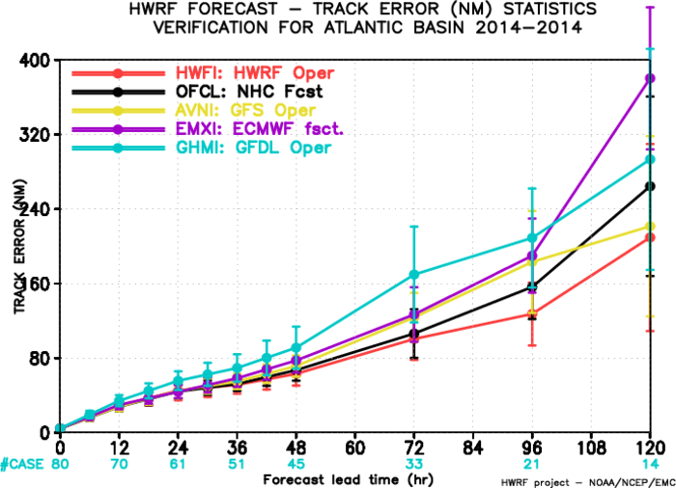
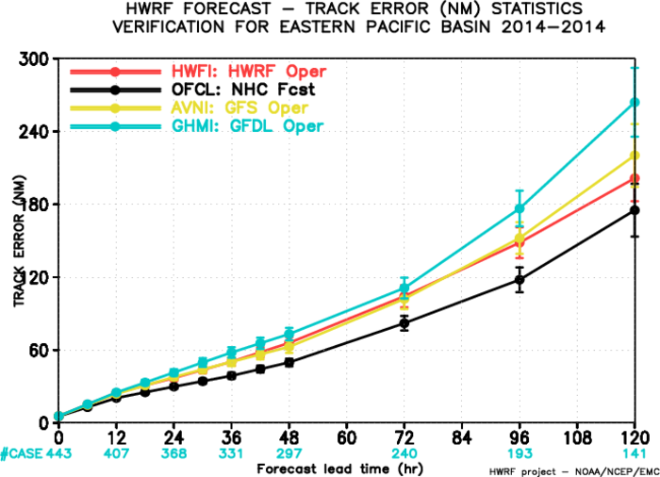
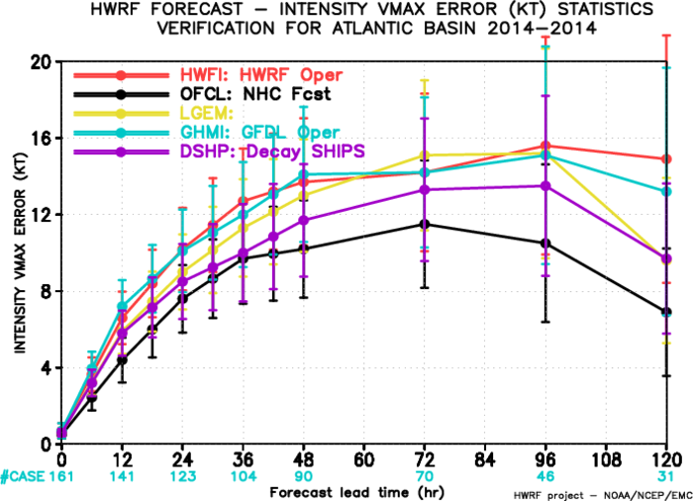
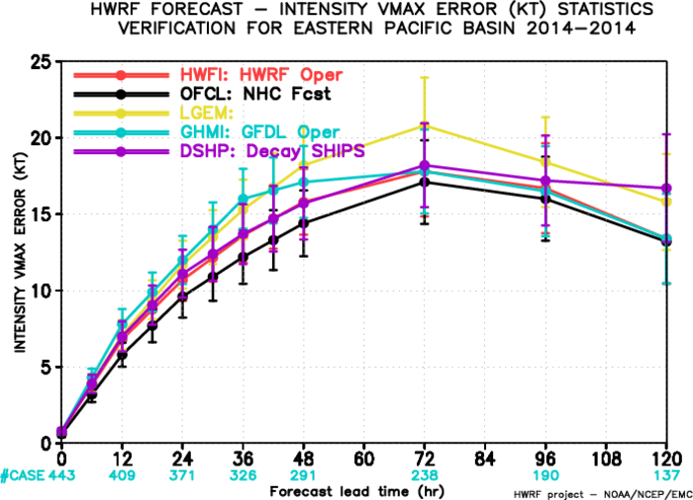
HWRF in 2014
Real-Time Performance in ATL and EP basins
NATL: Track errors
EPAC: Track errors
NATL: Intensity errors
EPAC: Intensity errors
Notes:
HWRF Track Forecast Errors for the Atlantic showed much superior skill compared to any other regional and global models, outperformed NHC official forecasts for the first time. Intensity forecasts suffered from significant negative bias, which will be the main focus area for 2015 upgrades.

Slide 5
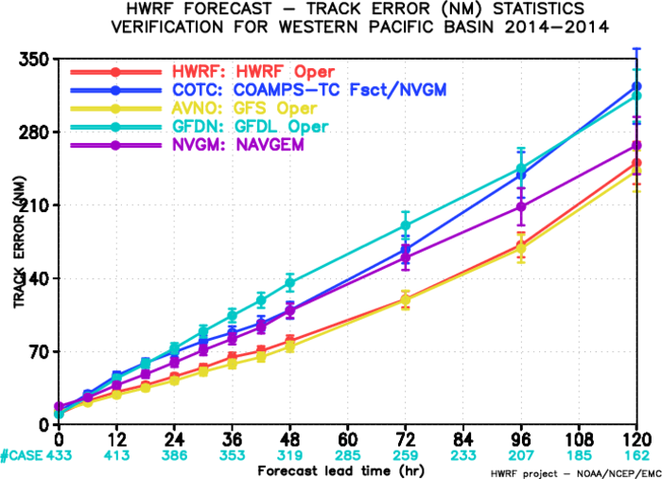
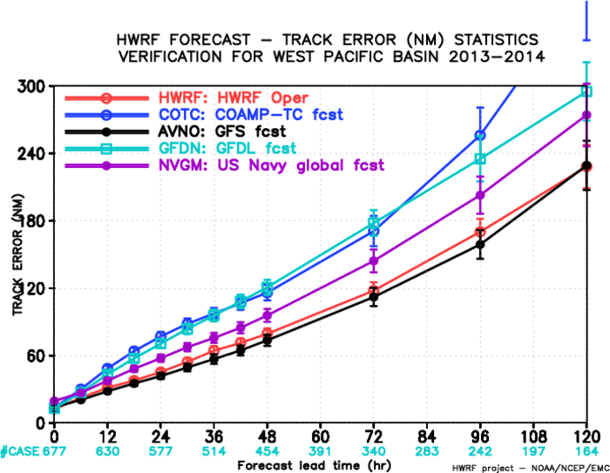
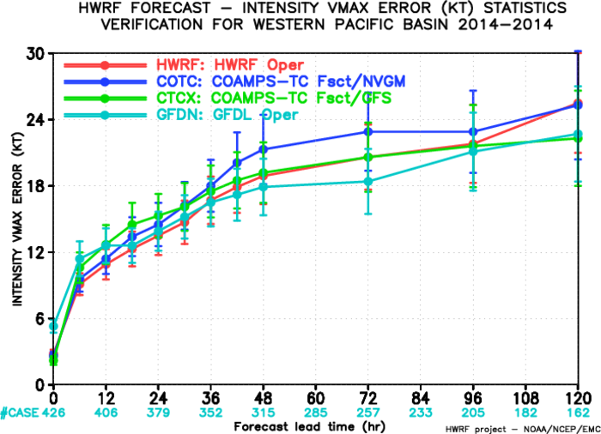
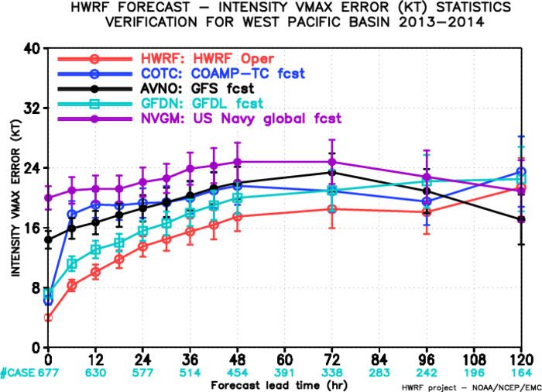
HWRF in 2014
Real-Time Performance in WPAC basin
WPAC: 2014 Track errors
WPAC: Track errors
2013-2014
WPAC: 2014 Intensity errors
WPAC: Intensity errors
2013-2014
5
Notes:
HWRF Track Forecast Errors for the Atlantic showed much superior skill compared to any other regional and global models, outperformed NHC official forecasts for the first time. Intensity forecasts suffered from significant negative bias, which will be the main focus area for 2015 upgrades.

Slide 6
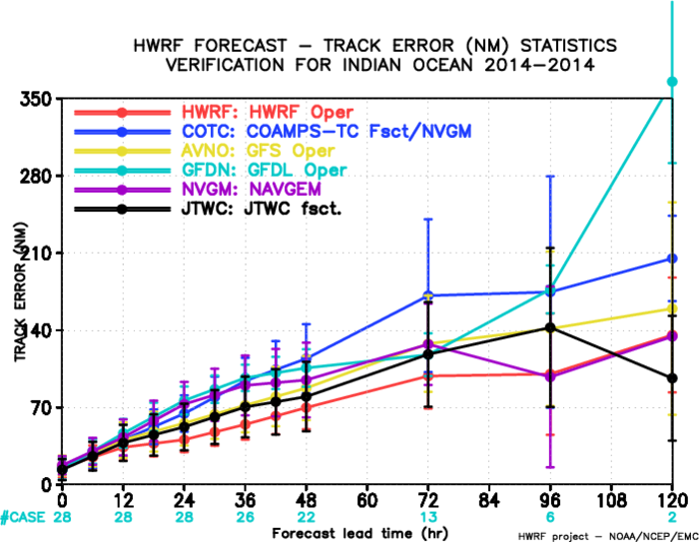
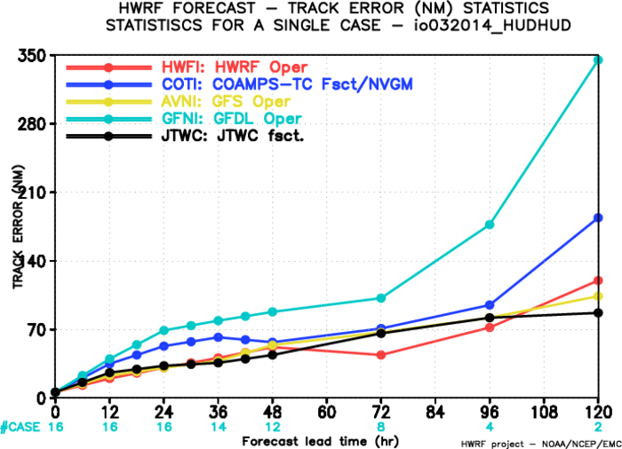
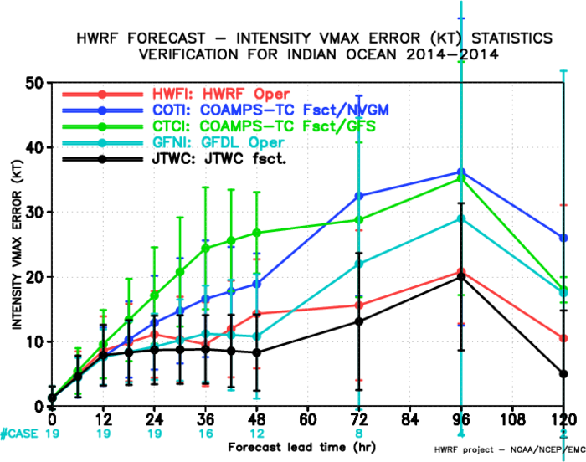
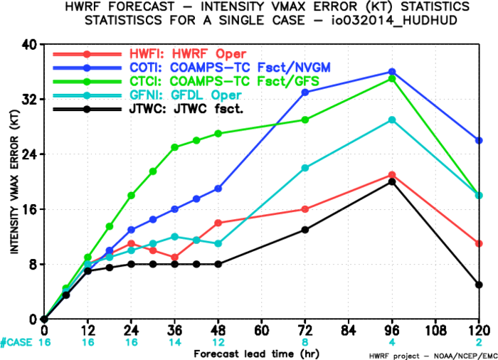
HWRF in 2014
Real-Time Performance in NIO basin
NIO: 2014 Track errors
VSCS Hudhud
NIO: 2014 Track errors
NIO: 2014 Intensity errors
NIO: 2014 Intensity errors
VSCS Hudhud
Notes:
HWRF Track Forecast Errors for the Atlantic showed much superior skill compared to any other regional and global models, outperformed NHC official forecasts for the first time. Intensity forecasts suffered from significant negative bias, which will be the main focus area for 2015 upgrades.

Slide 7
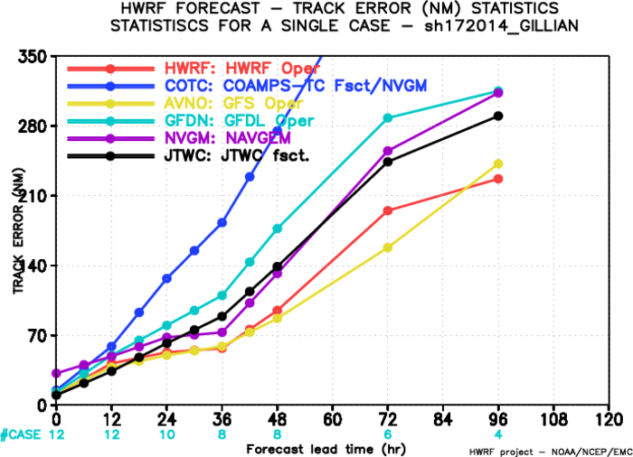
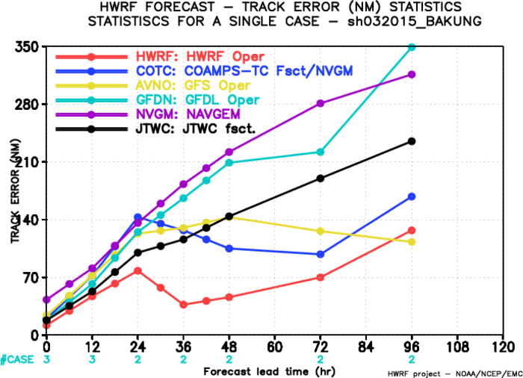
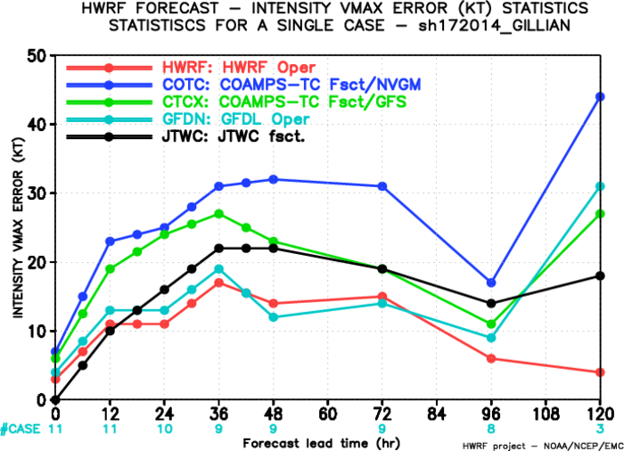
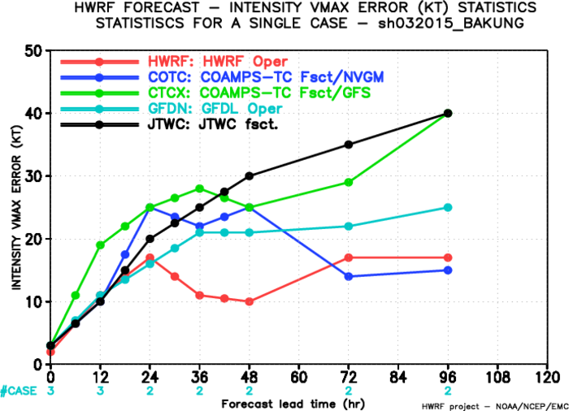
HWRF in 2014/2015
Real-Time Performance in Southern Hemisphere
Mar. ‘14
Dec. ‘14
SH: Track Errors
Typhoon Gillian 17P
SH: Track Errors
Typhoon Bakung 03S
SH: Intensity Errors
Typhoon Gillian 17P
SH: Intensity Errors
Typhoon Bakung 03S
Notes:
HWRF Track Forecast Errors for the Atlantic showed much superior skill compared to any other regional and global models, outperformed NHC official forecasts for the first time. Intensity forecasts suffered from significant negative bias, which will be the main focus area for 2015 upgrades.

Slide 8
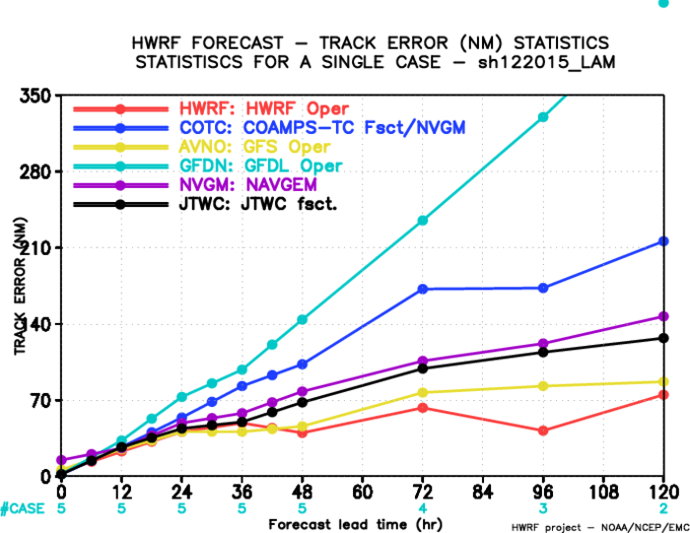
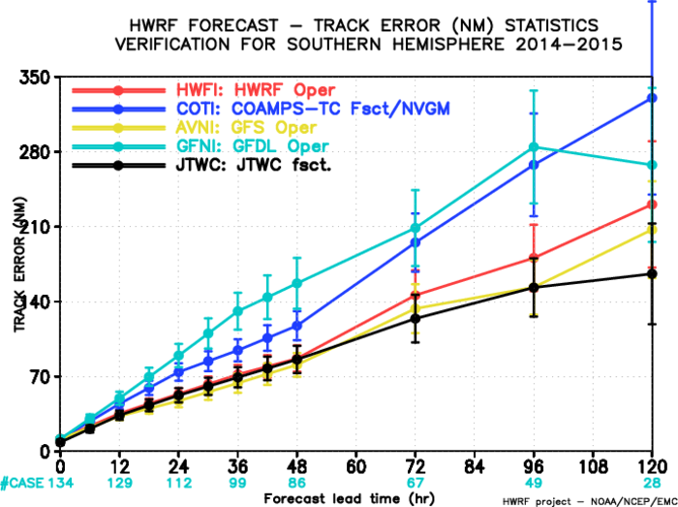
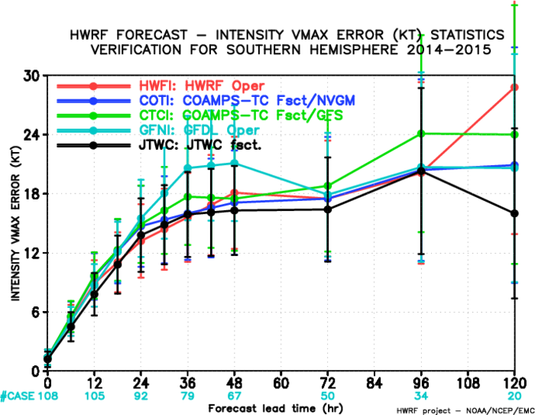
HWRF in 2014/2015
Real-Time Performance in Southern Hemisphere
SH: Track Errors
Typhoon Lam 12S
SH: Track Errors
2014/2015
Feb. ‘15
SH: Intensity Errors
Typhoon Lam 12S
SH: Intensity Errors
2014/2015
8
Notes:
HWRF Track Forecast Errors for the Atlantic showed much superior skill compared to any other regional and global models, outperformed NHC official forecasts for the first time. Intensity forecasts suffered from significant negative bias, which will be the main focus area for 2015 upgrades.

Slide 9
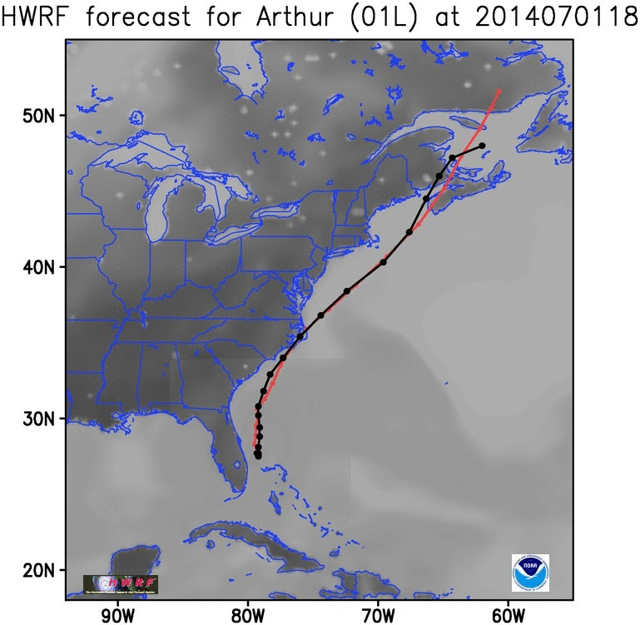
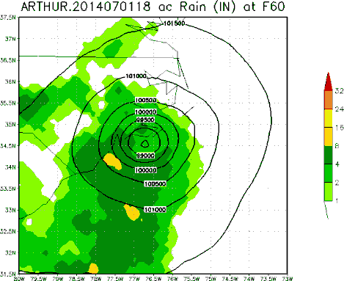
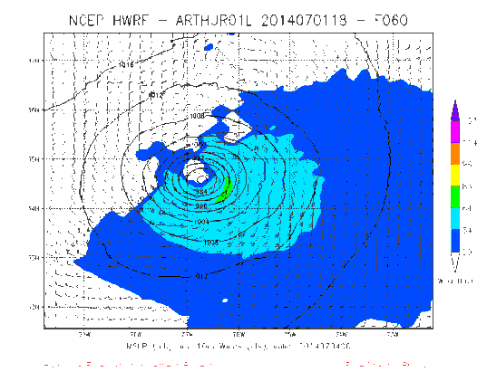
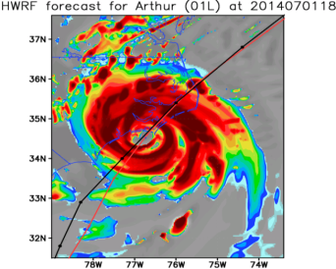
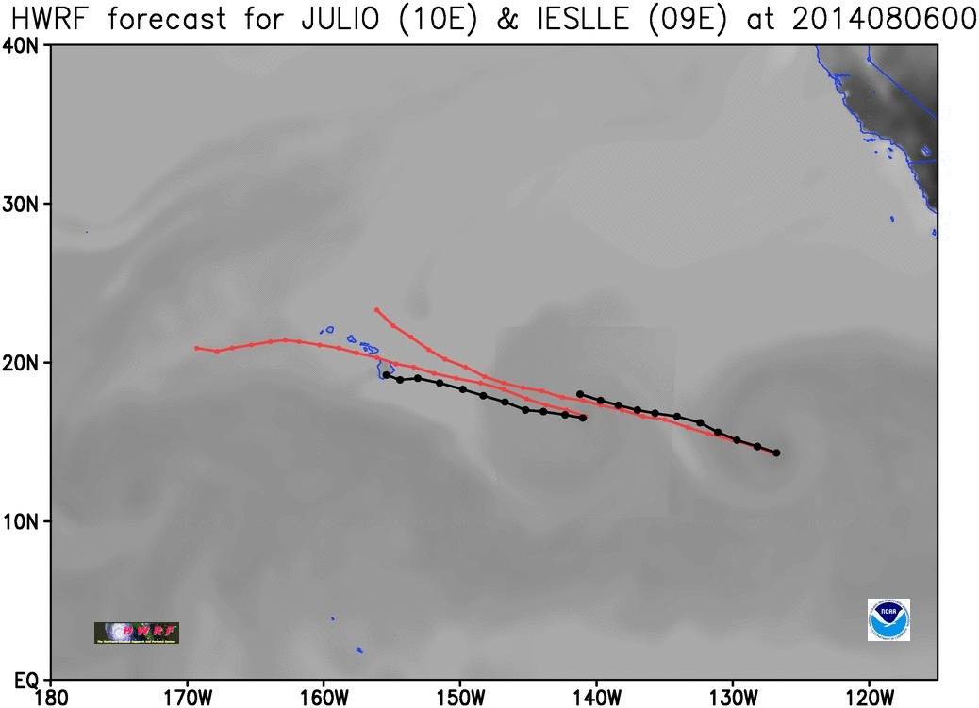
Examples of Real-Time Forecasts from 2014 HWRF
Advanced forecast products and high-definition graphics
Notes:
Perfect track, intensity and landfall forecasts for Hurricane Arthur. HWRF forecasts for Iselle and Julio are well behaved. Products included synthetic satellite imagery, radar reflectivity, high-resolution rain and wind distribution.

Slide 10
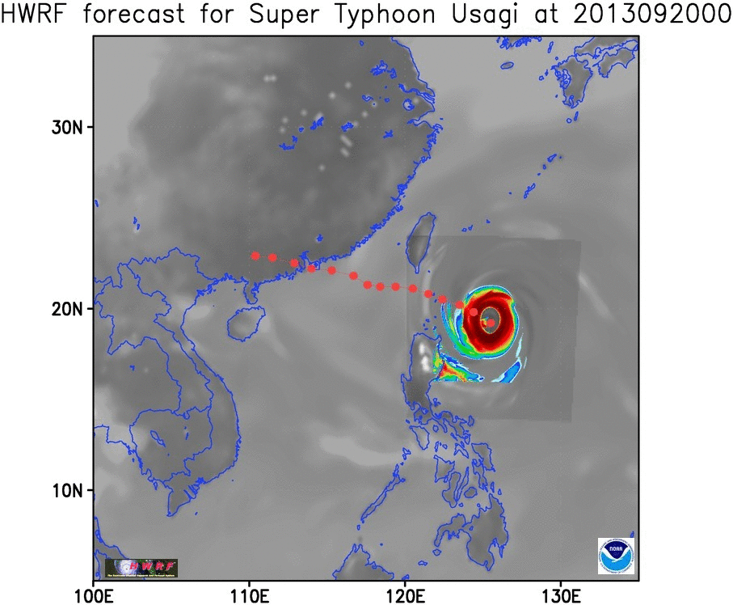
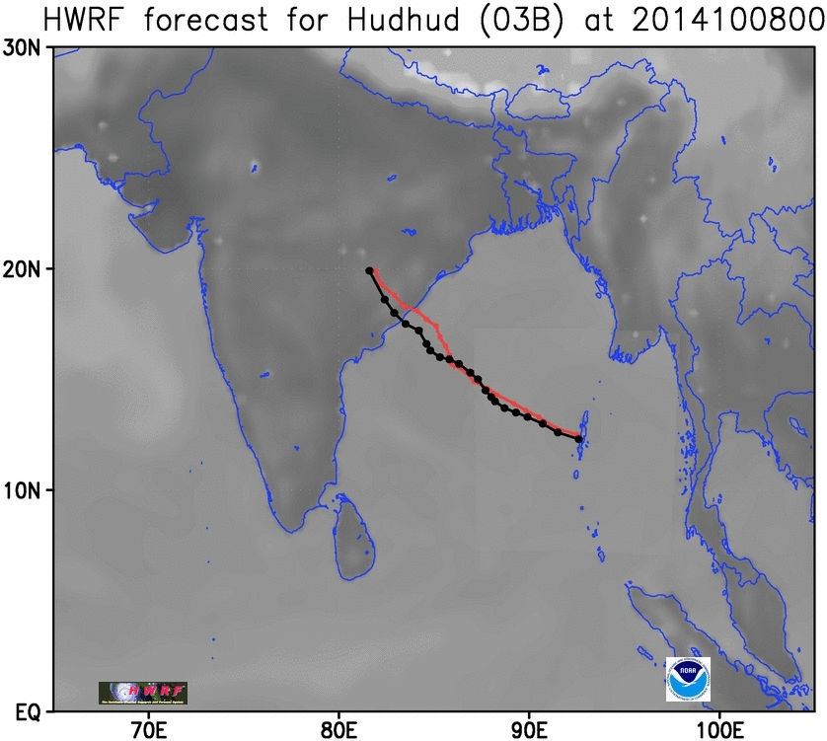
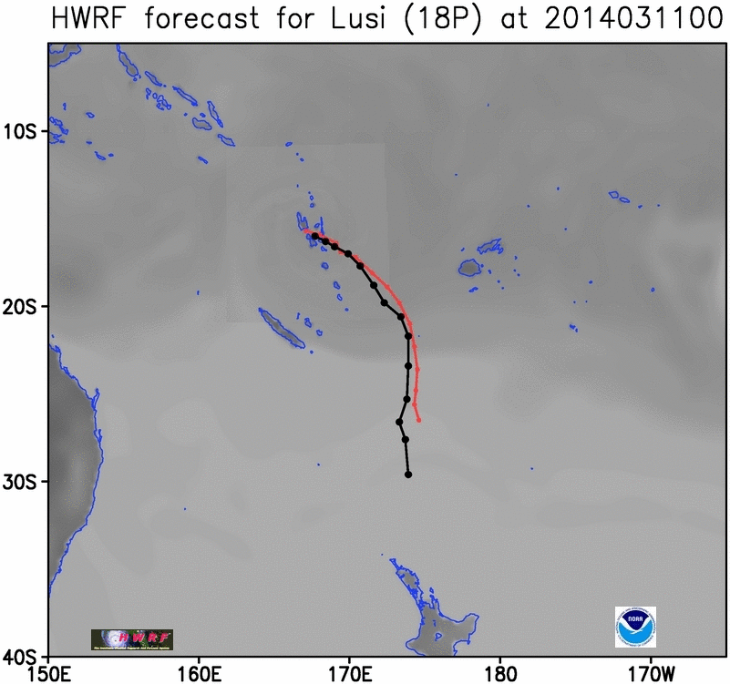
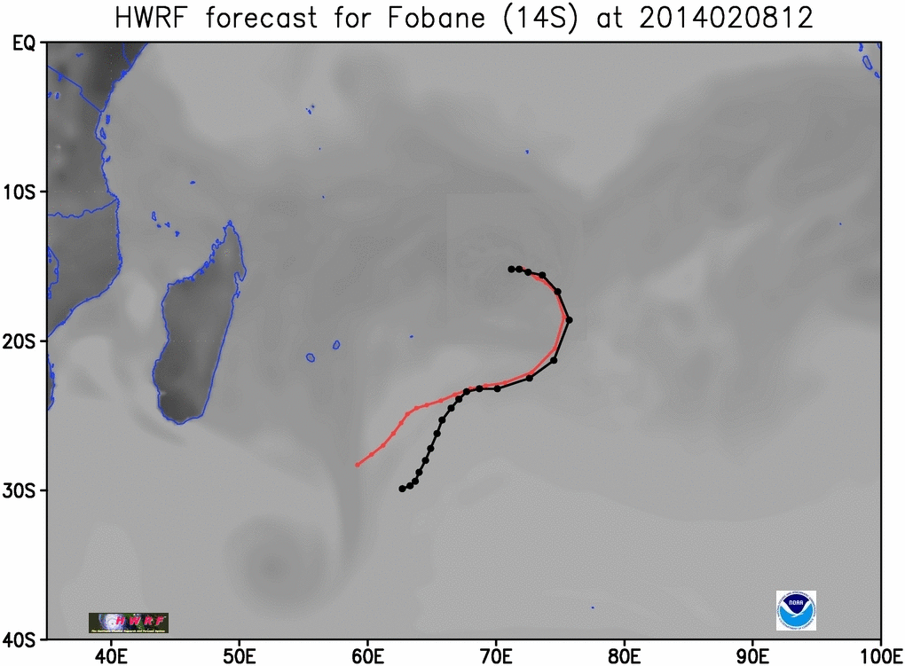
Examples of Real-Time Forecasts from 2014 HWRF
Advanced forecast products and high-definition graphics
NORTH INDIAN
WESTERN PACIFIC
SOUTHERN PACIFIC
SOUTH INDIAN
10

Slide 11

Recognition from US Dept. of Commerce: The 2014 Gold Medal for HWRF Team
NWS: Vijay Tallapragada; Qingfu Liu; William Lapenta; Richard Pasch; James Franklin; Simon Tao-Long Hsiao; Frederick Toepfer;
OAR: Sundararaman Gopalakrishnan; Thiago Quirino & Frank Marks, Jr.
It gives me great pleasure to congratulate you for being selected by the Secretary of Commerce to receive a Group Gold Medal for Scientific/Engineering Achievement.
This medal is a testament to your hard work, dedication, and passion for public service. I am so proud of the many contributions you and the other award recipients have made across the breadth of the NOAA mission, especially using your expertise and creativity to develop and implement an advanced Hurricane Weather Research and Forecast System model, which significantly improves hurricane intensity prediction.
You are a fine example of the wonderful talent we have in this agency. Congratulations, and thank you on behalf of NOAA and the Nation!
Kathryn D. Sullivan, PhD
Under Secretary of Commerce for Oceans and Atmosphere
and Administrator, National Oceanic and Atmospheric Administration
U.S. Department of Commerce

Slide 12
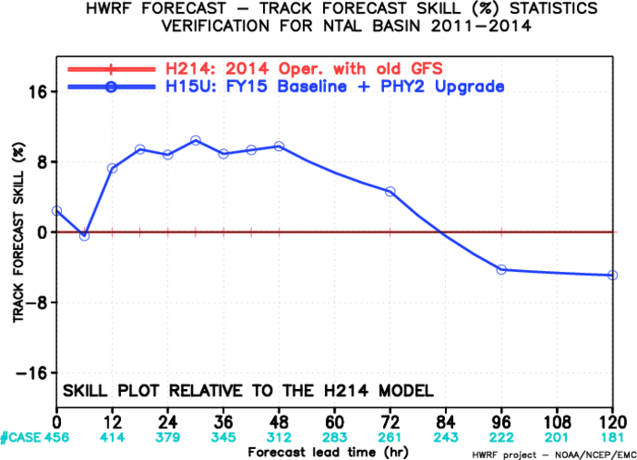
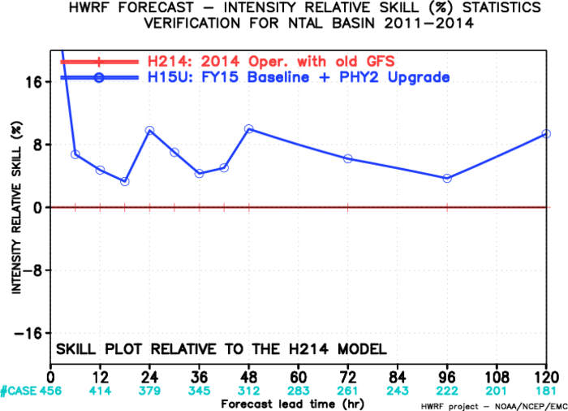
Potential HWRF Upgrades for 2015 Hurricane Season
Increased horizontal resolution to ~18/6/2 km, and Improved Physics
  GFS T1534 for initial and 0.25º grib2 master files for lateral boundary conditions
  Vortex initialization modifications for increased resolution
  Data Assimilation to include 40-member HWRF ensemble for inner-core aircraft DA
  Assimilate MSLP and HS3 dropsonde data
  New Ferrier-Aligo Microphysics and RRTMG Radiation
  Improved GFS PBL (UCLA)
  Improved physics at the air-sea interaction (URI)
  Improved cloud-radiation interactions (NCAR/DTC)
  Implementation of NOAH LSM (Purdue/NSF)
  Additional Products: Experimental tornado genesis parameters to become operational
  Products for downstream applications (Hurricane Wave and RTMA), Experimental products for hydrology and river routing models
Implement 7-storm capability to provide forecast guidance for all global tropical cyclones in support of NWS PR and JTWC
More details in Sam Trahan’s Talk: S5a-06
Expected improvements from FY15 HWRF
ATL Track improvements
ATL Intensity improvements

Slide 13
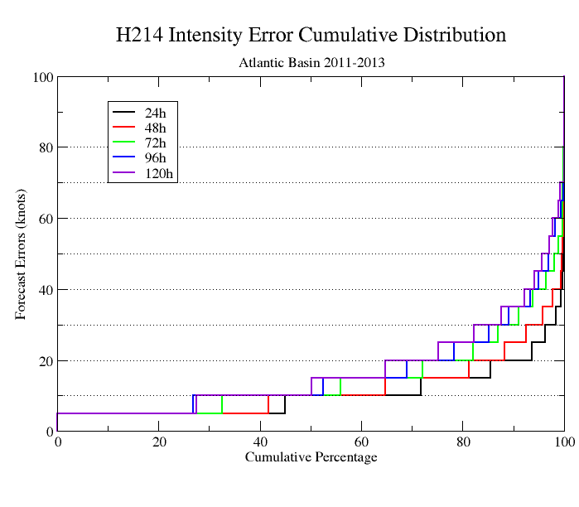
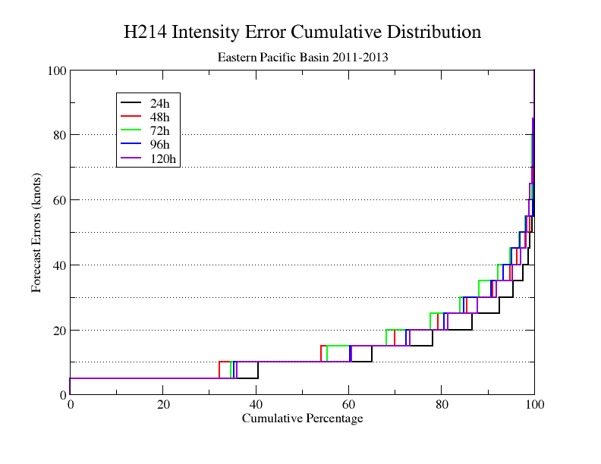
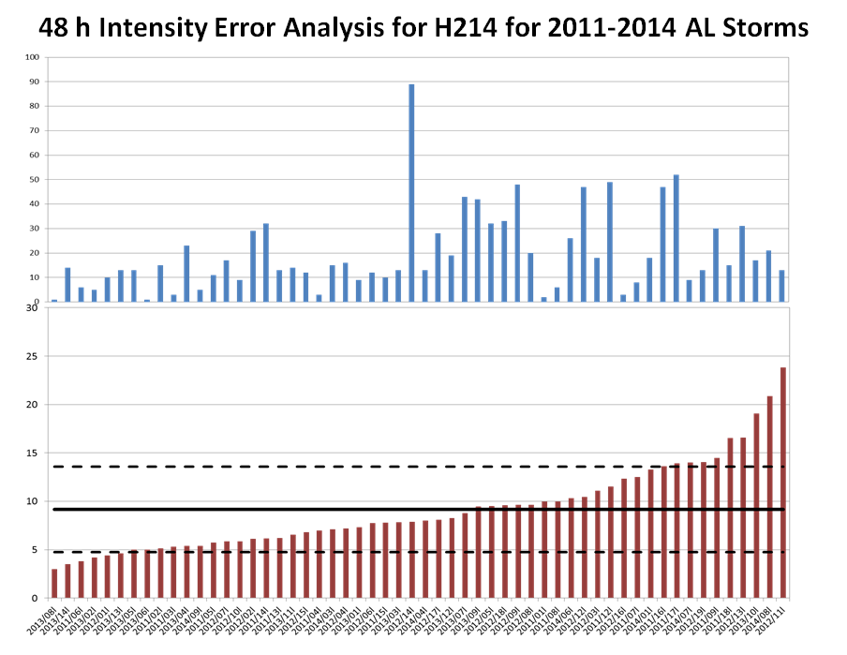
FY15 HWRF Implementation Strategy: Outlier based evaluation: EMC-NHC-HRD-DTC-SUNYA Collaboration
`
Test plan
  Outlier analysis based evaluation (NHC method)
  Choice of priority cases based on input/feedback from NHC
  Focus on track/intensity/size/structure/rainfall/RI/RW metrics (Jun Zhang)
  Additional diagnostics for spatial distribution of errors (Chun-Sil Jin)
  Conditional verification and diagnostics (Ryan Torn, DTC, Kate Musgrave, Dave Zelinsky)

Slide 14
Special Real-Time Projects supported by HFIP/HIWPP
HFIP Multi-Model Regional Ensembles
  20-member HWRF Ensembles w/GEFS and stochastic physics
  10-member GFDL Ensembles; 10-member COAMPS-TC Ensembles
  See John Moskaitas’s talk (S5b-02)
HFIP Stream 2: Advanced Self-Consistent EnKF based Data Assimilation
  Collaborative effort between ESRL, OU, PSU, Utah, Wisc. and EMC: See Jason Sippel’s talk (S5b-04)
  Initial results from assimilation of high-density GOES-R AMVs in HWRF: See Will Lewis’s talk (S5a-05)
HFIP Stream 2: Basin-Scale (hemispheric) HWRF (with multiple moveable domains)
    Collaborative effort between HRD/AOML, NPS and EMC: See Gopal’s talk (S5a-02)
Improved ocean models for HWRF and GFDL
  Contributions from URI: See Isaac’s talk (S3b-02)
Improved Physics in HWRF
  Contributions from DTC/UCLA/NCAR: See Christina’s talk (S3b-04)
HFIP OMITT: Geared to conclusively demonstrate the impact and importance of atmosphere-ocean coupled modeling for TC forecasts
  Collaborative effort between AOML, URI, ESRL, DTC and EMC: See Hyun-Sook Kim’s talk (S5a-04)
Transition HWRF into NMMB/NEMS Configuration: Unified regional modeling at NCEP
  Supported by HIWPP and HFIP: See Vijay’s talk (S5a-03)

Slide 15
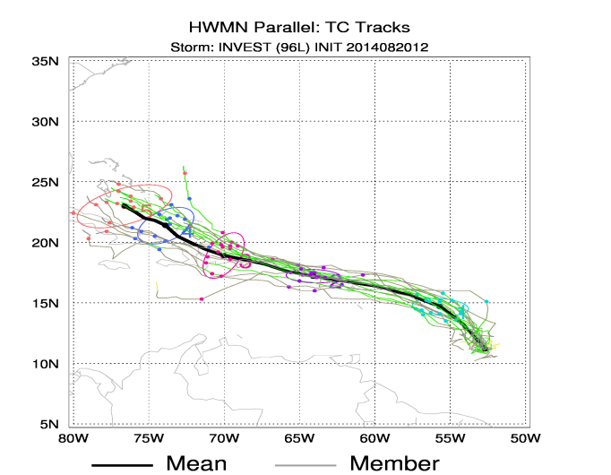
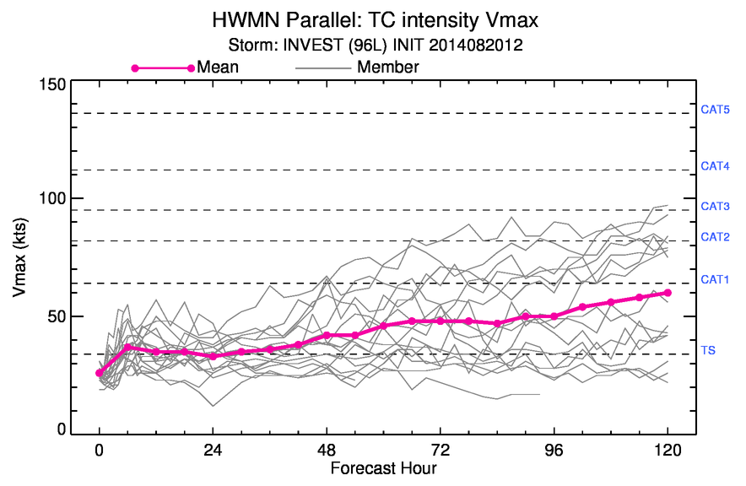
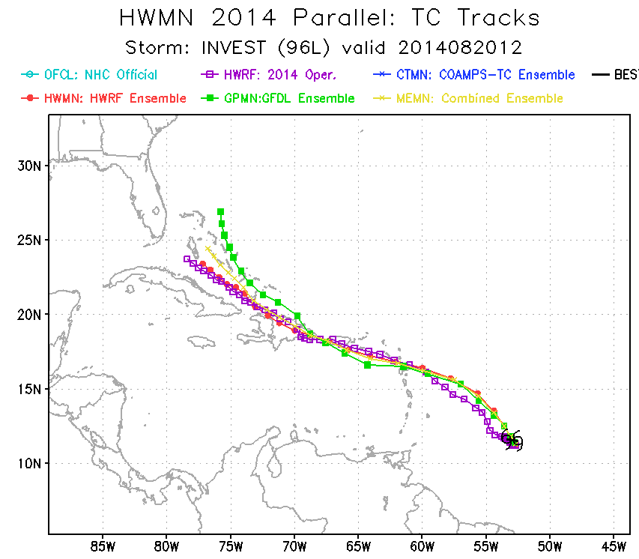
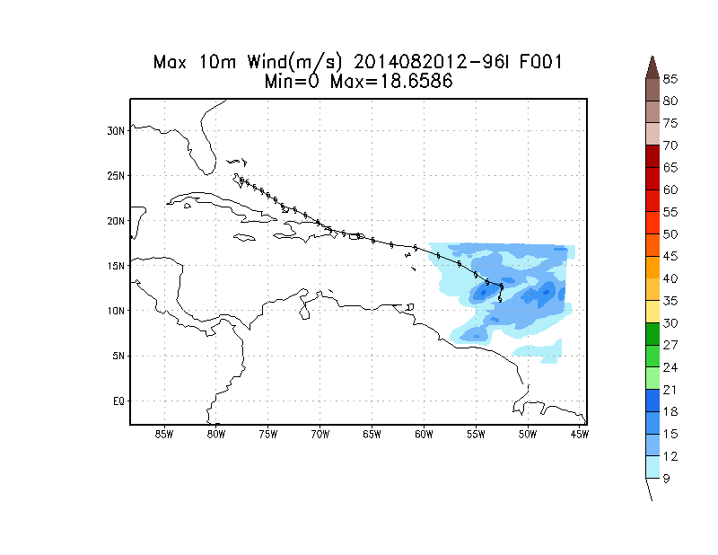
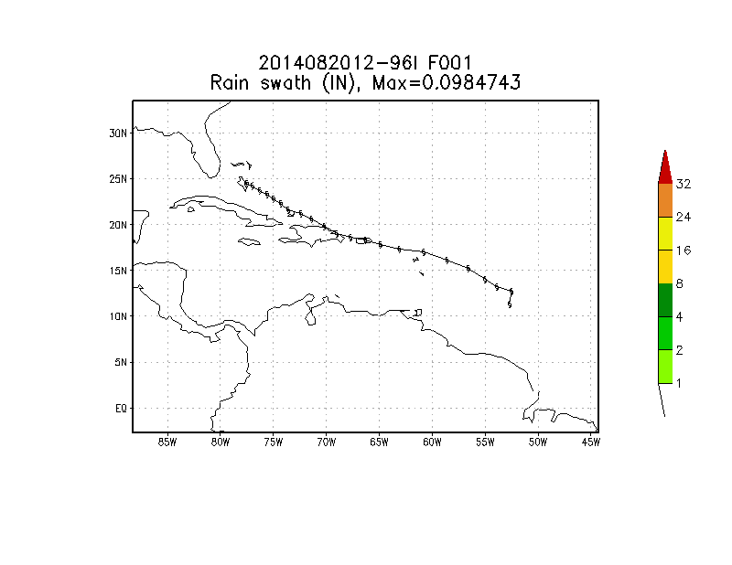
HFIP Joint Multi-Center Regional Ensemble Prediction System
Real-Time Results for the developing storm in the Atlantic: 96L, IC: 2014082012
For more real-time products, visit the HWRF website at:
http://www.emc.ncep.noaa.gov/HWRF/ENSEMBLE/index.html
A Major R2O Effort between EMC/NCEP, NRL and GFDL
15
Notes:
Ran real-time 20-member HWRF ensembles for majority of the Atlantic storms.

Slide 16
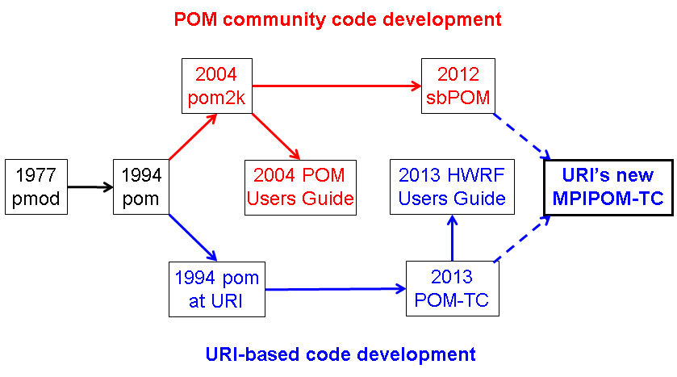
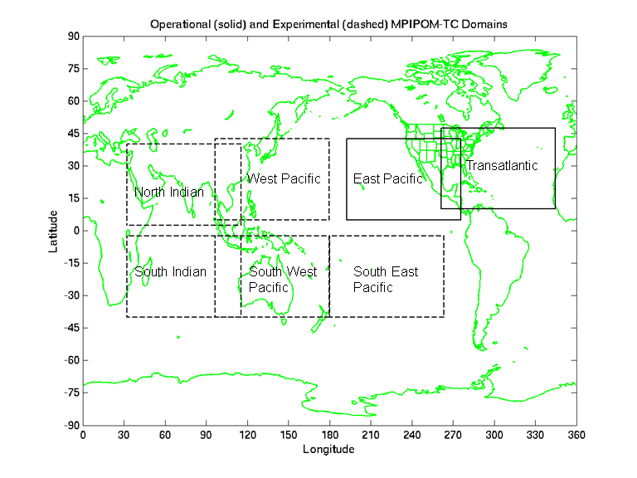
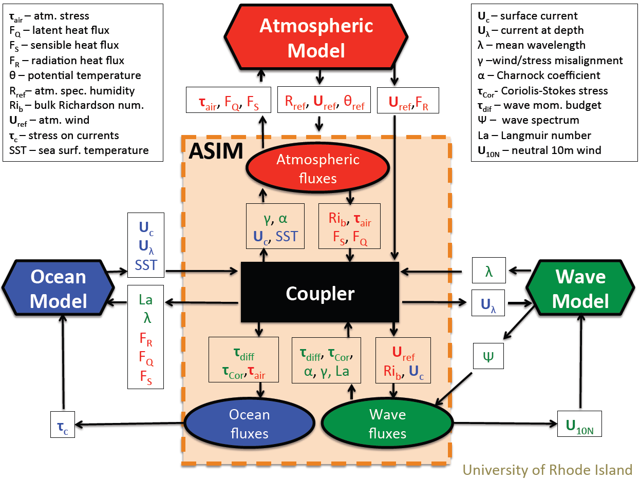
R2O: Advancing Ocean/Wave Coupling for HWRF: URI
MPIPOM-TC for global basins is available through HWRF repository at DTC
Flexible initialization options:
NCODA, GDEMv3, HYCOM, or Feature-based (Atlantic only); with or without GFS SST assimilation
NetCDF I/O
Single prognostic code in all worldwide ocean basins

Slide 17
High Priority: Address Rapid Short-term Intensity Error Growth
Development of Advanced Ensemble Based Hurricane Data Assimilation System: Another R2O effort in collaboration with ESRL, OU, Utah, PSU, U. Wisconsin, UMD & NESDIS

Slide 18
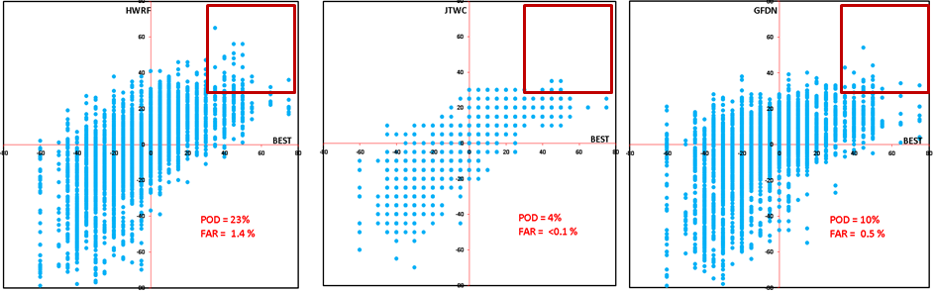
High Priority: Improved RI/RW forecasts
HWRF as the most skillful real-time forecast model for RI predictions
Verification of RI in terms of category events shows superior RI forecast skill of the HWRF model as compared to other regional models at JTWC with high POD and very low FAR
Tallapragada and Kieu, 2014: Real-Time Forecasts of Typhoon Rapid Intensification in the North Western Pacific Basin with the NCEP Operational HWRF model. TCRR, in press.
Kieu, Tallapragada and Hoggsett, 2014: Vertical structure of tropical cyclones at onset of the rapid intensification in the HWRF model Geophysical Research Letters; Volume 41, Issue 9, 16 May 2014, Pages: 3298–3306

Slide 19
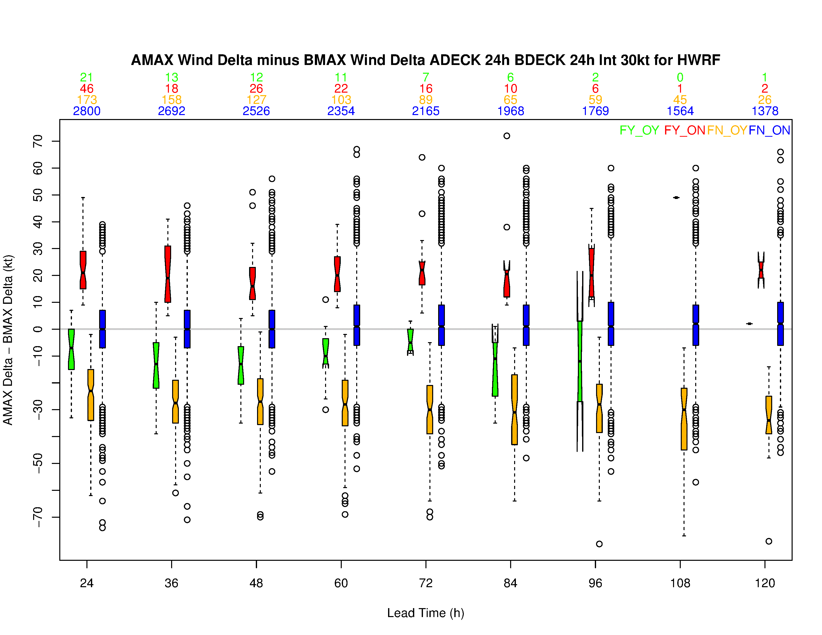

HWRF RI verification – Atlantic and Eastern Pacific Basins
Fcst OBS | Y | N
Y | 128 | 1623
N | 253 | 37654
POD | 7.3%
FAR | 66.4%
When HWRF detects RI, it under-forecasts its magnitude
HWRF over-predicts by 15-20 kt for False Alarms, however, under-predicts by 20-25 kts when it misses RI events
All verifications are for cases over water only
RI Verification is a new capability in MET-TC and will be included in the next release.
http://www.dtcenter.org/met/users/
Notes:
The box plot shows (24hr previous intensity – Current Intensity for Adecks) Minus (24hr previous intensity – Current Intensity for Bdecks). Ideal hits will be close to 0 line when both increments match.
The data includes H214 pre-implementation and 2014 operational HWRF datasets.
The top numbers indicates number of cases for the 4 quadrants of the Contingency tables.

Slide 20
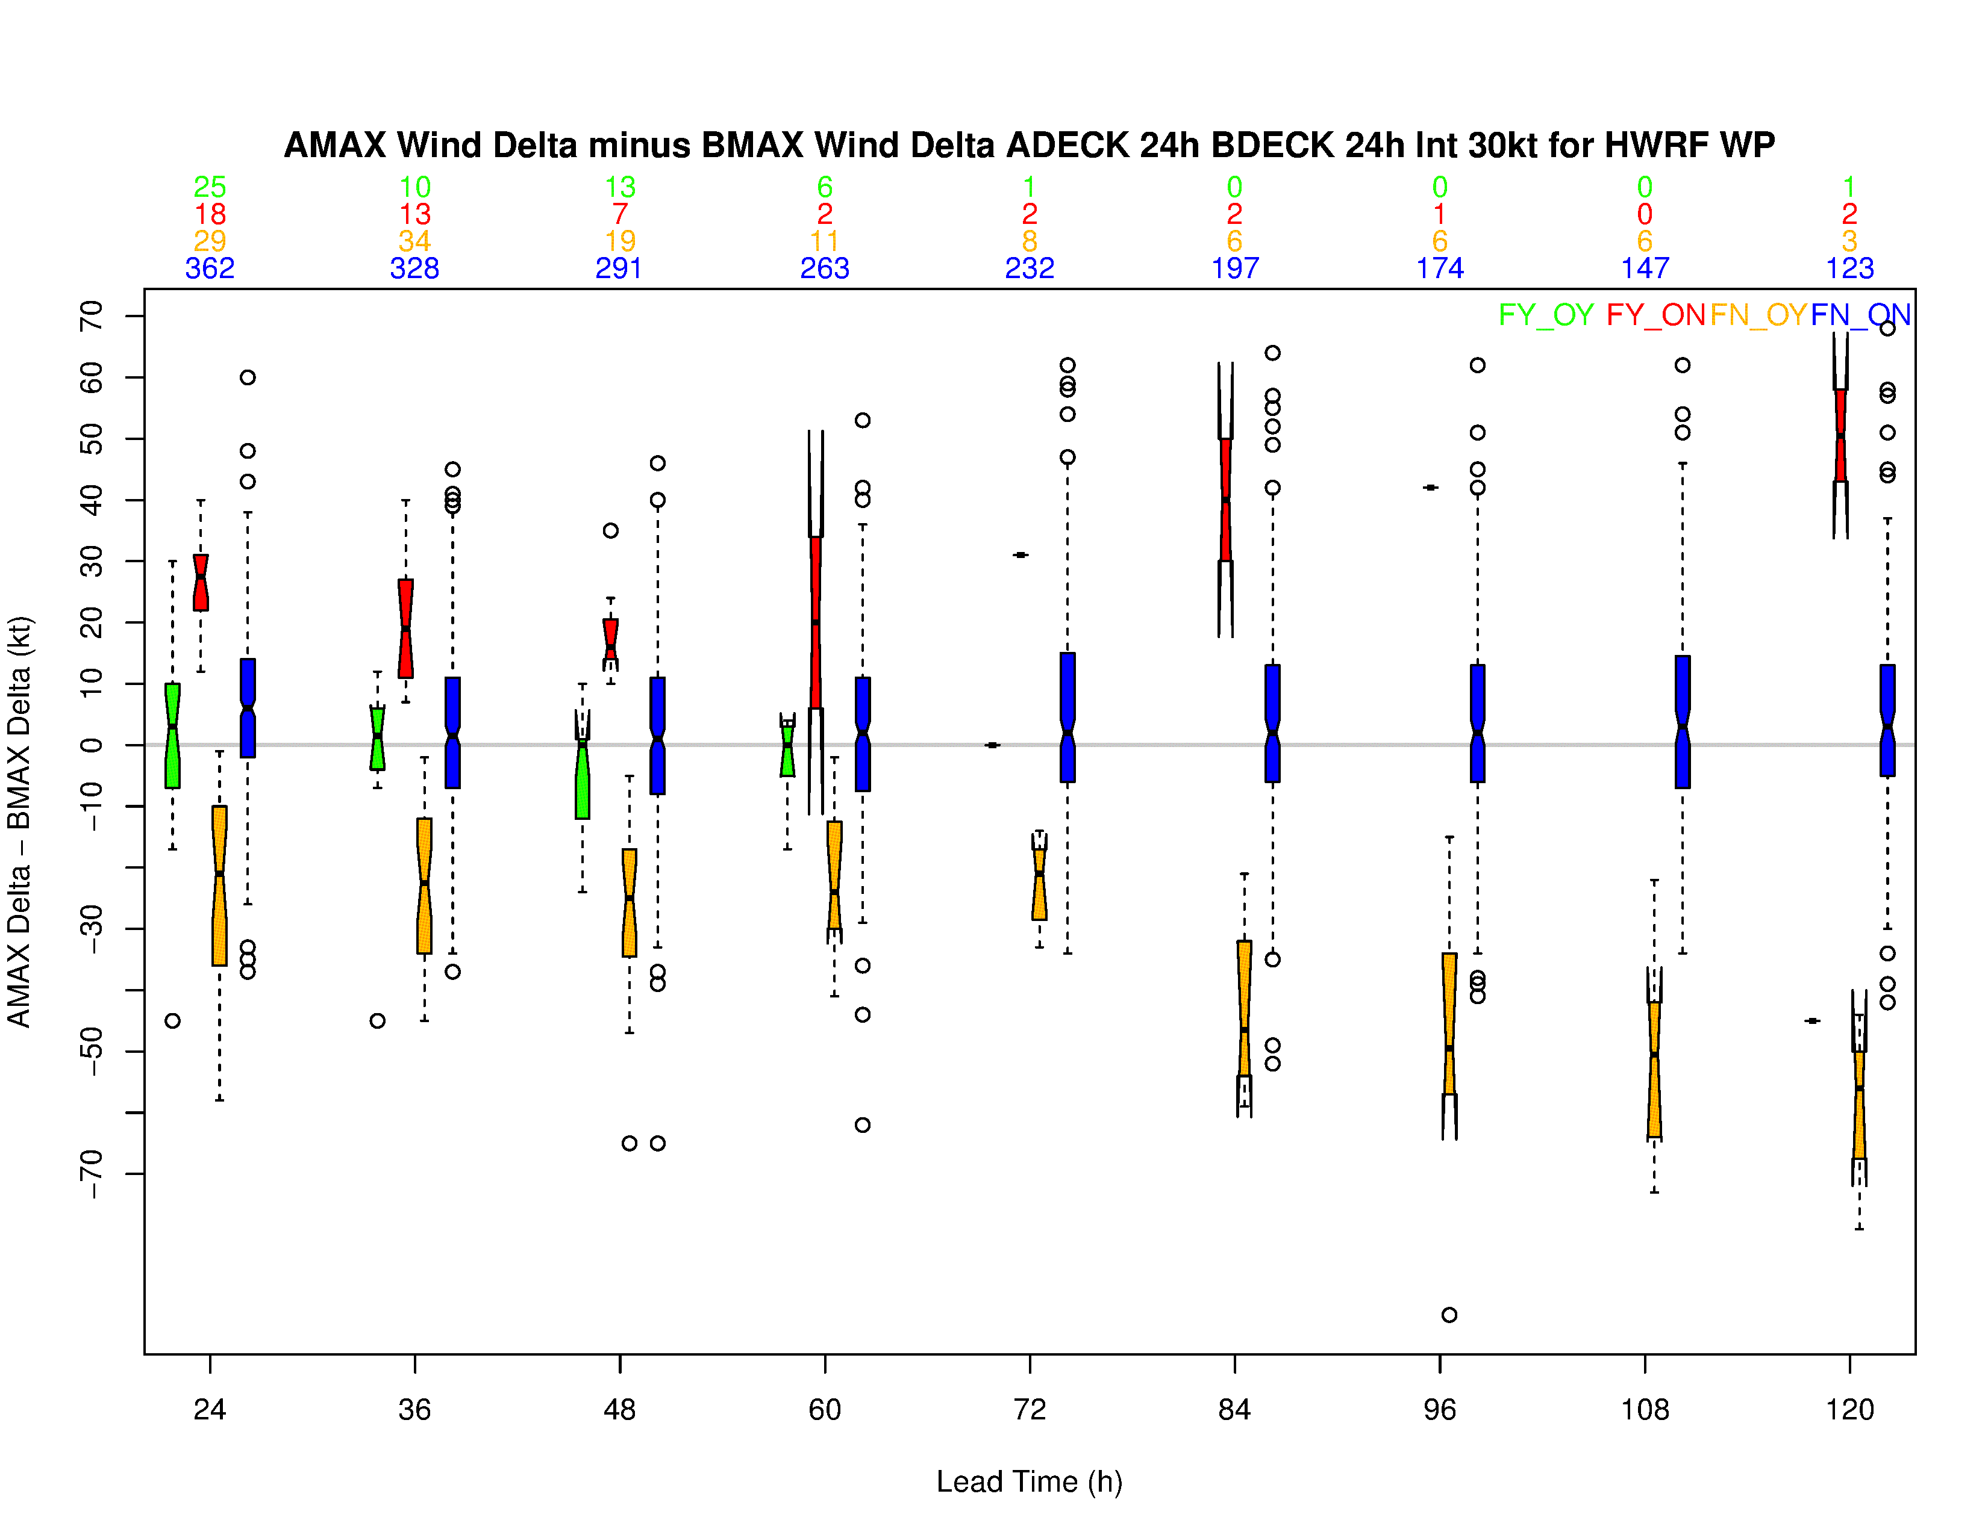
HWRF RI verification – Western Pacific Basin
Fcst OBS | Y | N
Y | 94 | 233
N | 71 | 4127
POD | 28.7%
FAR | 43%
Difference in HWRF and OBS intensity increment median for RI’s close to OBS error (±5 kt)
HWRF’s POD for RI over W Pac is much higher than AL and EP basins
Notes:
W Pac includes realtime HWRF datasets for 2013-2014.

Slide 21
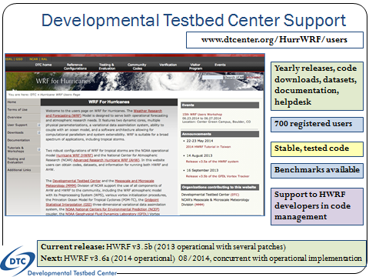









HWRF as a unique global tropical cyclone model
Run in real-time for all global tropical cyclones in support of NHC, JTWC and other international operational agencies across the Asia Pacific and North Indian Ocean regions
Continue the community modeling approach for accelerated transition of research to operations
International partnerships for accelerated model development & research

Slide 22
Thanks for your attention
Real-time and pre-implementation T&E
HWRF products:
http://www.emc.ncep.noaa.gov/gc_wmb/vxt/index.html
Questions?
Acknowledgements:
HWRF team at EMC
EMC and HFIP Management
Collaborations with various national and international agencies
Notes:
22

